Slide 1
DS4023（2025 Fall） Machine Learning Department of Computer Science Beijing Normal-Hong Kong Baptist University

Slide 2
Chapter 8: Dimensionality Reduction
Subspace methods

Slide 3
Outline
Principal Component Analysis
Linear Discriminant Analysis
Nonnegative Matrix Factorization
Multi-Dimensional Scaling
Manifold Embedding
Locally Linear Embedding

Slide 4
Chapter 8.1: Principal Component Analysis

Slide 5
Motivation
Principal Component Analysis (PCA) and Linear Discriminant Analysis (LDA) are multivariate statistical techniques that are often useful in reducing dimensionality of a collection of unstructured random variables for analysis and interpretation.
PCA: 主成分分析
LDA: 线性判别分析(Supervised Learning)

Slide 6
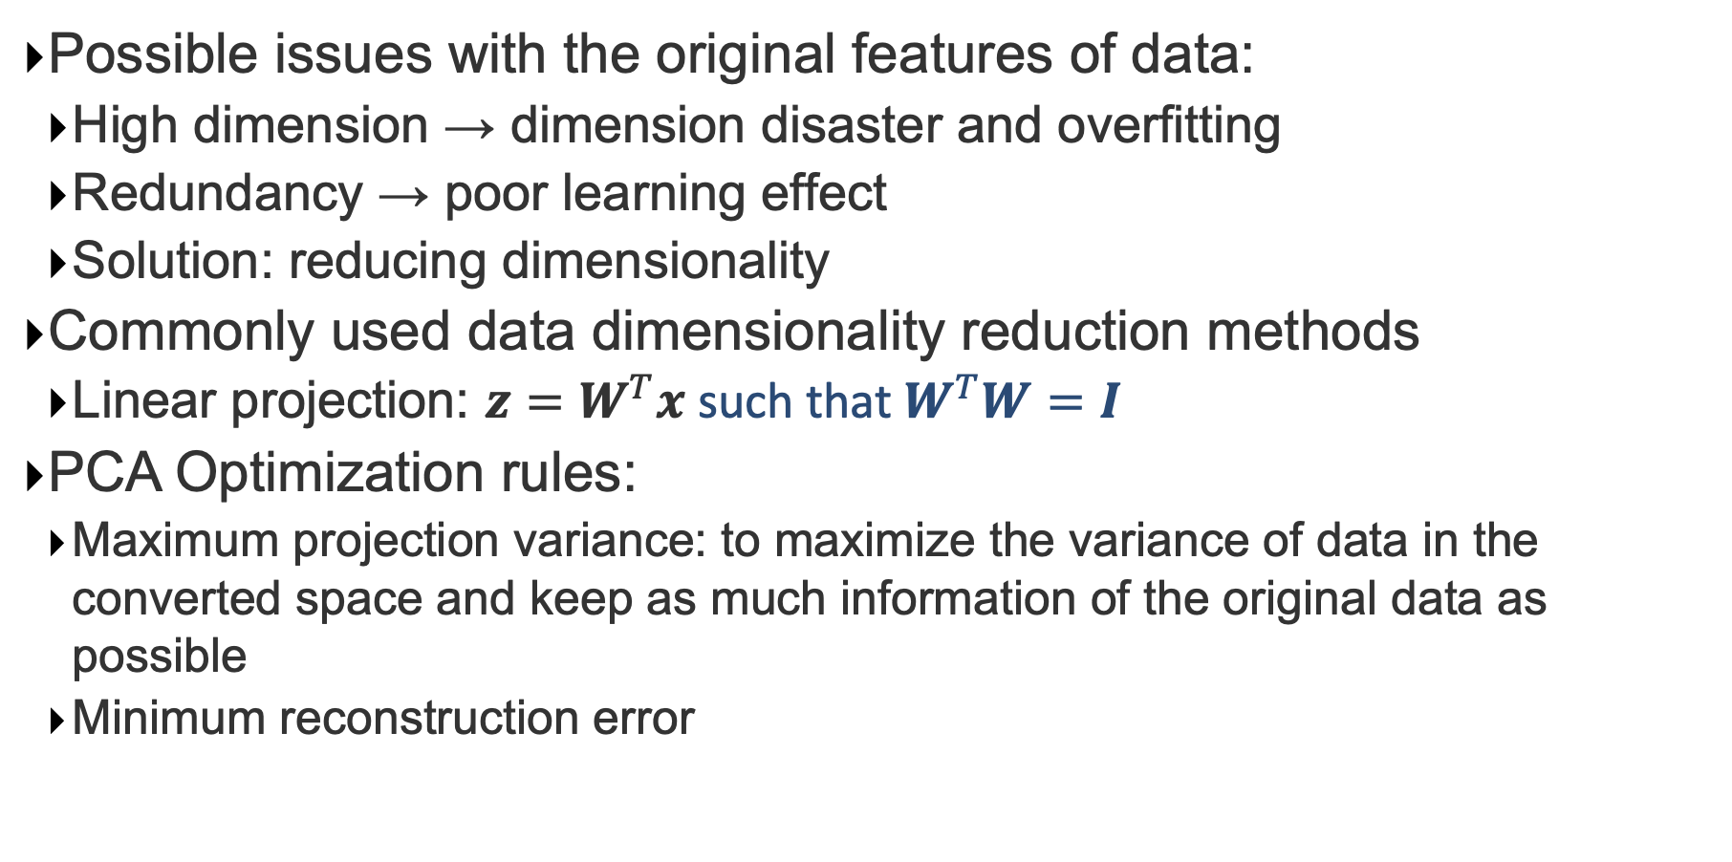
Motivation
Possible issues with the original features of data:
High dimension → dimension disaster and overfitting
Redundancy → poor learning effect
Solution: reducing dimensionality
Commonly used data dimensionality reduction methods
Linear projection: $z=W^{T}x$ such that $W^{T}W=I$
PCA Optimization rules:
Maximum projection variance: to maximize the variance of data in the converted space and keep as much information of the original data as possible
Minimum reconstruction error

Slide 7
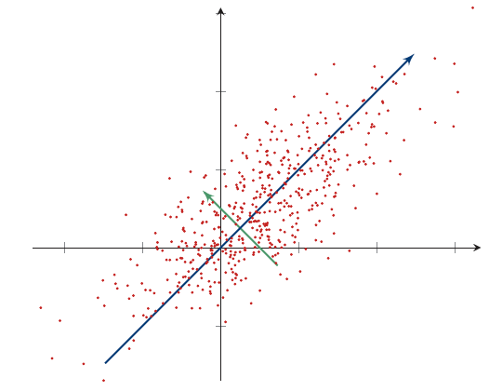
Motivation

Slide 8
Problem Statement
• Let X be an m-dimensional random vector with the covariance matrix C. The problem is to consecutively find the unit vectors a₁, a₂, . . . , a_{m} such that y_{i}= x^{t} a_{i} with Y_{i} = X^{t} a_{i} satisfies
1. var(Y₁) is the maximum.
2. var(Y₂) is the maximum subject to cov(Y₂, Y₁)=0.
3. var(Y_{k}) is the maximum subject to cov(Y_{k}, Y_{i})=0,
where k = 3, 4, · · ·,m and k > i.
• Y_{i} is called the i-th principal component
• Feature extraction by PCA is called PCP

Slide 9
The Solutions
Let (λ_{i}, u_{i}) be the pairs of eigenvalues and eigenvectors of the covariance matrix C such that
λ₁ ≥ λ₂ ≥ . . . ≥ λ_{m} ( ≥0 )
and
∥u_{i} ∥₂ = 1, ∀ 1 ≤ i ≤ m.
Then
a_{i} = u_{i} and var(Y_{i})=λ_{i} for 1 ≤ i ≤ m.

Slide 10
Computations
Given n observations x₁, x₂, . . . , x_{n} of m-dimensional column vectors
1. Compute the mean vector μ = (x₁+x₂+. . . +x_{n} )/n
2. Compute the covariance matrix by MLE
C = (1/n) Σ_{i=1}^{n} (x_{i} − μ)(x_{i} − μ)^{t}
3. Compute the eigenvalue/eigenvector pairs (λ_{i}, u_{i}) of C
with λ₁ ≥ λ₂ ≥ . . . ≥ λ_{m} ( ≥0 )
4. Compute the first d principal components y_{i}^{(j)} = x_{i}^{t} u_{j}, for each observation x_{i}, 1 ≤ i ≤ n, along the direction u_{j} , j = 1, 2, · · · , d.
5. (λ₁ +λ₂ + . . . + λ_{d})/ (λ₁ +λ₂ + . . .+ λ_{d} + . . .+ λ_{m}) > 85%

Slide 11
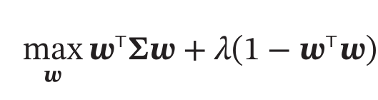
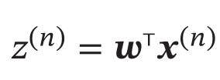
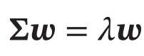
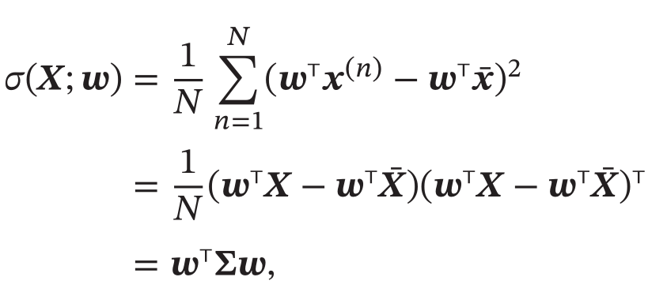
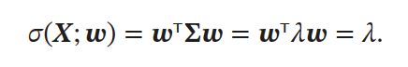
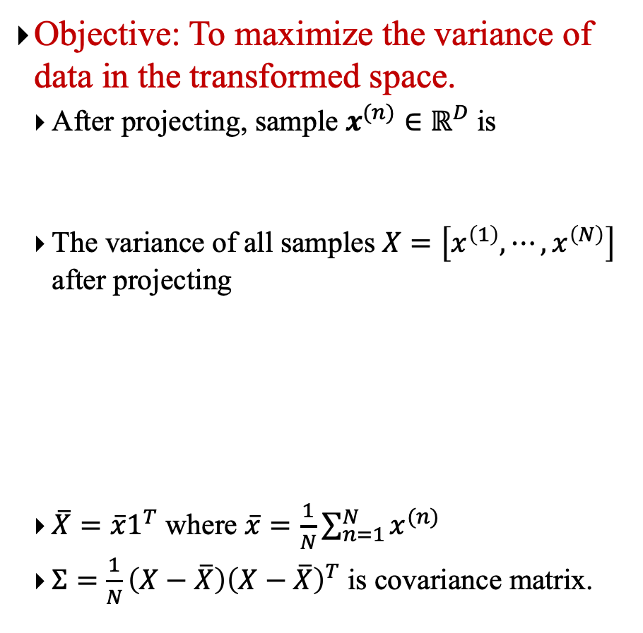
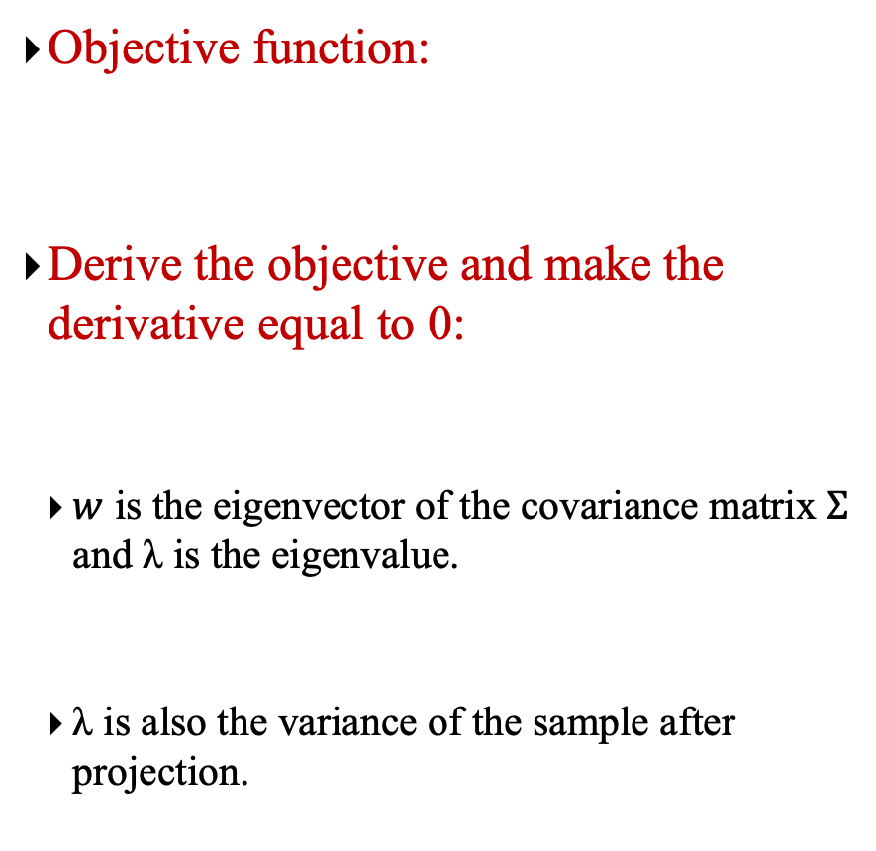
PCA: One Dimension
Objective: To maximize the variance of data in the transformed space.
After projecting, sample $x^{(n)}∈ℝ^{D}$ is
The variance of all samples $X=\left[x^{\left(1\right)},⋯,x^{\left(N\right)}\right]$ after projecting
$\overline{X}=\overline{x}1^{T}$ where $\overline{x}=\frac{1}{N}\sum_{n=1}^{N}{x^{(n)}}$
$Σ=$ $\frac{1}{N}\left(X−\overline{X}\right){\left(X−\overline{X}\right)}^{T}$ is covariance matrix.
Objective function:
Derive the objective and make the derivative equal to 0:
$w$ is the eigenvector of the covariance matrix $Σ$ and λ is the eigenvalue.
λ is also the variance of the sample after projection.
Notes:
sigma: 原始空间中x的协方差矩阵

Slide 12
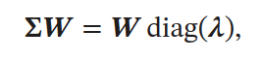
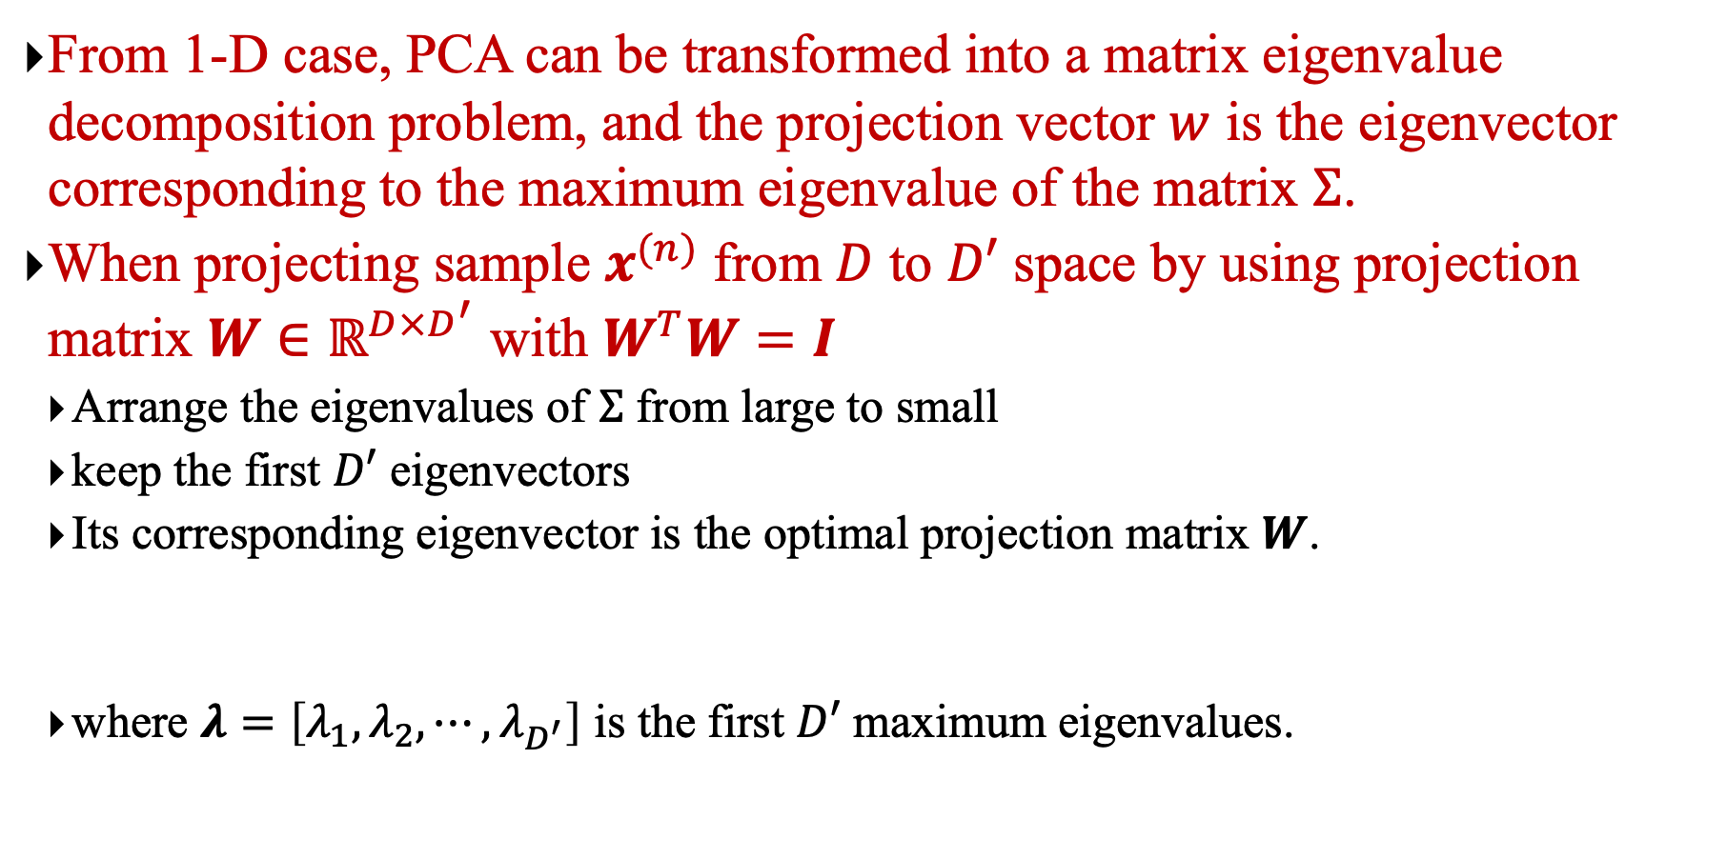
PCA: From One Dimension to Multi Dimension
From 1-D case, PCA can be transformed into a matrix eigenvalue decomposition problem, and the projection vector $w$ is the eigenvector corresponding to the maximum eigenvalue of the matrix $Σ$.
When projecting sample $x^{(n)}$ from $D$ to $D′$ space by using projection matrix $W∈ℝ^{D×D^{′}}$ with $W^{T}W=I$
Arrange the eigenvalues of $Σ$ from large to small
keep the first $D′$ eigenvectors
Its corresponding eigenvector is the optimal projection matrix $W$.
where $λ=\left[λ_{1},λ_{2},⋯,λ_{D^{′}}\right]$ is the first $D′$ maximum eigenvalues.

Slide 13
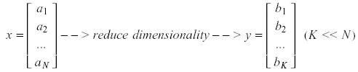
Principal Component Analysis (PCA)
Pattern recognition in high-dimensional spaces
Problems arise when performing recognition in a high-dimensional space (curse of dimensionality).
Significant improvements can be achieved by first mapping the data into a lower-dimensional sub-space.
The goal of PCA is to reduce the dimensionality of the data while retaining as much as possible of the variation present in the original dataset.

Slide 14
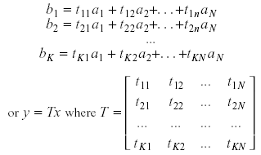
Principal Component Analysis (PCA)
Dimensionality reduction
PCA allows us to compute a linear transformation that maps data from a high dimensional space to a lower dimensional sub-space.

Slide 15
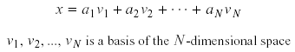
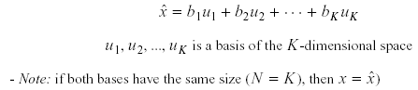
Principal Component Analysis (PCA)
Lower dimensionality basis
Approximate vectors by finding a basis in an appropriate lower dimensional space.
(1) Higher-dimensional space representation:
(2) Lower-dimensional space representation:

Slide 16
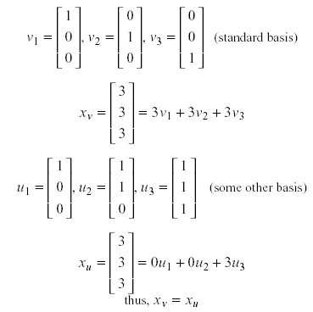
Principal Component Analysis (PCA)
Example

Slide 17
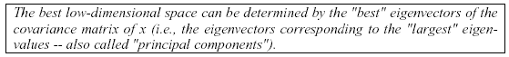
Principal Component Analysis (PCA)
Information loss
Dimensionality reduction implies information loss !!
Want to preserve as much information as possible, that is:
How to determine the best lower dimensional sub-space?

Slide 18
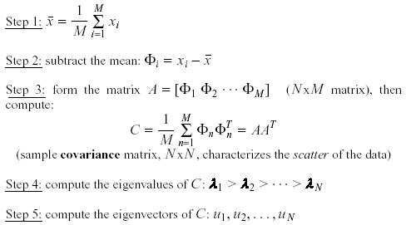
PCA Algorithm
Methodology
Suppose x₁, x₂, ..., x_{M} are N x 1 vectors
对样本进行中心化处理！

Slide 19
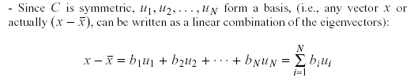
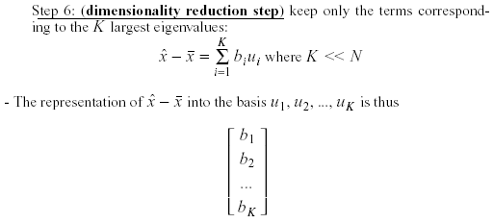
PCA Algorithm（cont.）
Methodology – cont.

Slide 20
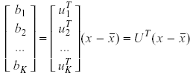
PCA Algorithm（cont.）
Linear transformation implied by PCA
The linear transformation R^{N} → R^{K} that performs the dimensionality reduction is:

Slide 21
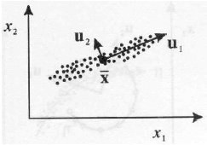
Principal Component Analysis (PCA)
Geometric interpretation
PCA projects the data along the directions where the data varies the most.
These directions are determined by the eigenvectors of the covariance matrix corresponding to the largest eigenvalues.
The magnitude of the eigenvalues corresponds to the variance of the data along the eigenvector directions.

Slide 22
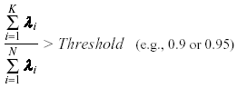
Principal Component Analysis (PCA)
How to choose the principal components?
To choose K, use the following criterion:

Slide 23
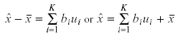
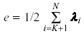
Principal Component Analysis (PCA)
What is the error due to dimensionality reduction?
We saw above that an original vector x can be reconstructed using its principal components:
It can be shown that the low-dimensional basis based on principal components minimizes the reconstruction error:
It can be shown that the error is equal to:

Slide 24
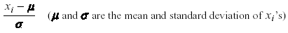
Principal Component Analysis (PCA)
Standardization
The principal components are dependent on the units used to measure the original variables as well as on the range of values they assume.
We should always standardize the data prior to using PCA.
A common standardization method is to transform all the data to have zero mean and unit standard deviation:

Slide 25
An Example for Computations
x₁ =[3.03, 2.82]^{t}
x₂ =[0.88, 3.49]^{t}
x₃ =[3.26, 2.46]^{t}
x₄ =[2.66, 2.79]^{t}
x₅ =[1.93, 2.62]^{t}
x₆ =[4.80, 2.18]^{t}
x₇ =[4.78, 0.97]^{t}
X₈ =[4.69, 2.94]^{t}
X₉ =[5.02, 2.30]^{t}
x₁₀ =[5.05, 2.13]^{t}
μ =[3.61, 2.37]^{t}
C = 1.9650 -0.4912
-0.4912 0.4247
λ₁ =2.1083
λ₂ =0.2814
u₁ =[0.9600, -0.2801]^{t}
u₂=[0.2801, 0.9600]^{t}

Slide 26
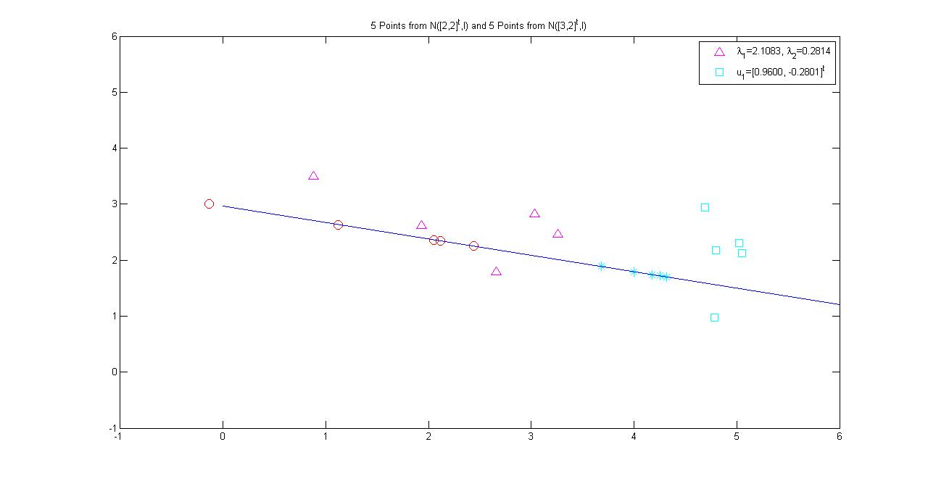
Results of Principal Projection

Slide 27
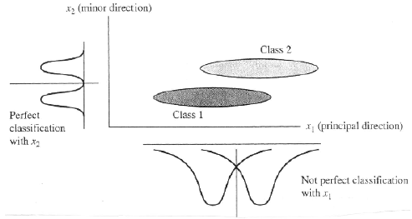
Principal Component Analysis (PCA)
PCA and classification
PCA is not always an optimal dimensionality-reduction procedure for classification purposes:

Slide 28
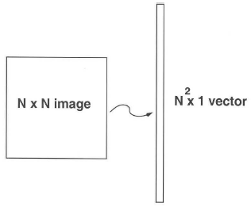
PAC: An example of EigenFaces
Case Study: Eigenfaces for Face Detection/Recognition
M. Turk, A. Pentland, "Eigenfaces for Recognition", Journal of Cognitive Neuroscience, vol. 3, no. 1, pp. 71-86, 1991.
Face Recognition
The simplest approach is to think of it as a template matching problem
Problems arise when performing recognition in a high-dimensional space.
Significant improvements can be achieved by first mapping the data into a lower dimensionality space.
How to find this lower-dimensional space?

Slide 29
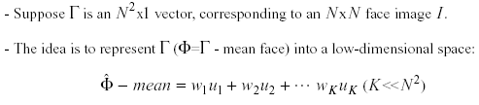
Principal Component Analysis (PCA)
Main idea behind eigenfaces

Slide 30
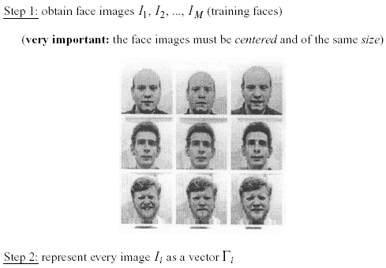
Principal Component Analysis (PCA)
Computation of the eigenfaces

Slide 31
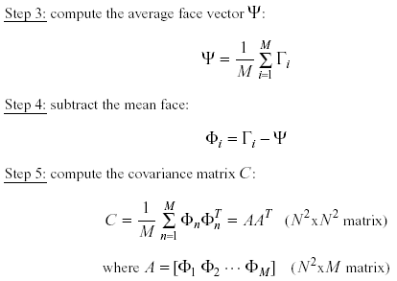
Principal Component Analysis (PCA)
Computation of the eigenfaces – cont.

Slide 32
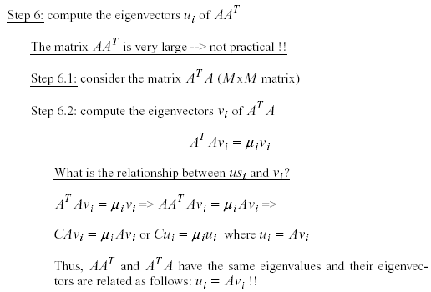
Principal Component Analysis (PCA)
Computation of the eigenfaces – cont.

Slide 33
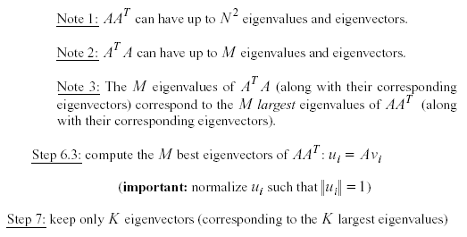
Principal Component Analysis (PCA)
Computation of the eigenfaces – cont.

Slide 34
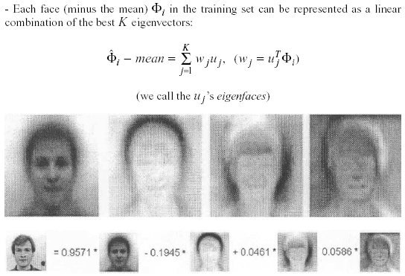
Principal Component Analysis (PCA)
Representing faces onto this basis

Slide 35
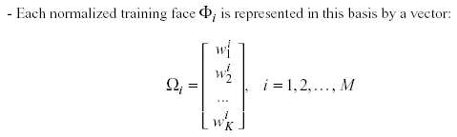
Principal Component Analysis (PCA)
Representing faces onto this basis – cont.

Slide 36
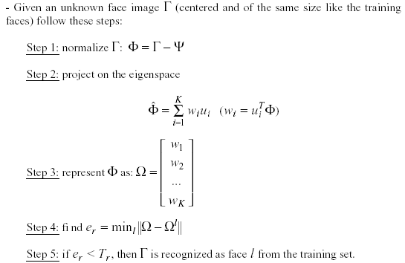
Principal Component Analysis (PCA)
Face Recognition Using Eigenfaces

Slide 37
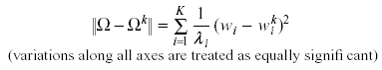
Principal Component Analysis (PCA)
Face Recognition Using Eigenfaces – cont.
The distance e_{r} is called distance within the face space (difs)
Comment: we can use the common Euclidean distance to compute e_{r}, however, it has been reported that the Mahalanobis distance performs better:

Slide 38
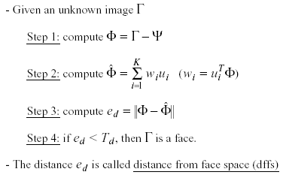
Principal Component Analysis (PCA)
Face Detection Using Eigenfaces

Slide 39
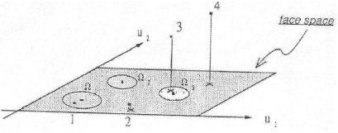
Principal Component Analysis (PCA)
Face Detection Using Eigenfaces – cont.

Slide 40
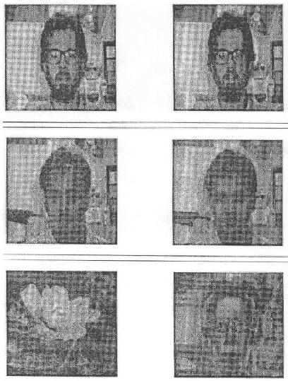
Principal Component Analysis (PCA)
Reconstruction of faces and non-faces

Slide 41
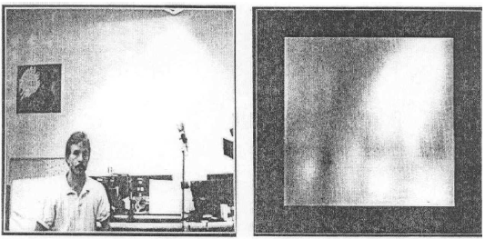
Principal Component Analysis (PCA)
Time requirements
About 400 ms (Lisp, Sun4, 128x128 images)
Applications
Face detection, tracking, and recognition

Slide 42
Principal Component Analysis (PCA)
Problems
Background (de-emphasize the outside of the face – e.g., by multiplying the input image by a 2D Gaussian window centered on the face)
Lighting conditions (performance degrades with light changes)
Scale (performance decreases quickly with changes to head size)
multi-scale eigenspaces
scale input image to multiple sizes
Orientation (performance decreases but not as fast as with scale changes)
plane rotations can be handled
out-of-plane rotations are more difficult to handle

Slide 43
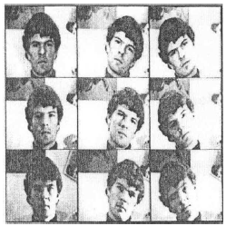
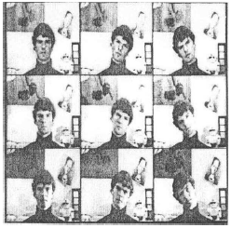
Principal Component Analysis (PCA)
Experiments
16 subjects, 3 orientations, 3 sizes
3 lighting conditions, 6 resolutions (512x512 ... 16x16)
Total number of images: 2,592

Slide 44
Principal Component Analysis (PCA)
Experiment 1
Used various sets of 16 images for training
One image/person, taken under the same conditions
Eigenfaces were computed offline (7 eigenfaces used)
Classify the rest images as one of the 16 individuals
No rejections (no threshold for difs)
Performed a large number of experiments and averaged the results:
96% correct averaged over light variation
85% correct averaged over orientation variation
64% correct averaged over size variation

Slide 45
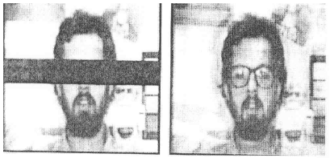
Principal Component Analysis (PCA)
Experiment 2
They considered rejections (by thresholding difs)
There is a tradeoff between correct recognition and rejections.
Adjusting the threshold to achieve 100% recognition accuracy resulted in:
19% rejections while varying lighting
39% rejections while varying orientation
60% rejections while varying size
Experiment 3
Reconstruction using partial information

Slide 46
Chapter 8.2: Linear Discriminant Analysis

Slide 47
Motivation
PCA: no guarantee that the category separability of the projected data is better. (Can‘t use for classification)
Find a linear combination of features that best separates two or more classes of objects or events
LDA: Projecting the data onto a lower-dimensional space while maximizing the separation between multiple classes
LDA is a supervised learning!!

Slide 48
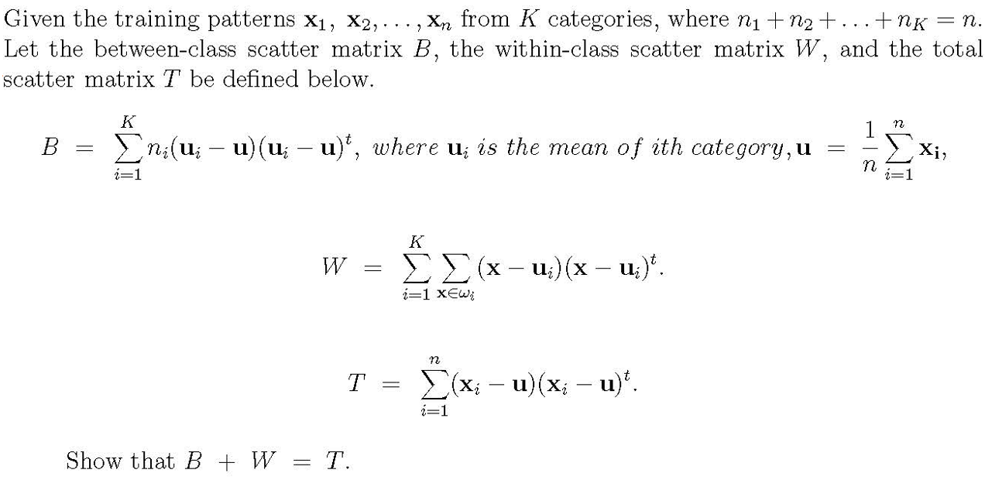
Fundamentals of LDA
Between-Class Scatter Matrix
Within-Class Scatter Matrix

Slide 49
Fundamentals of LDA
Given the training patterns x₁, x₂, . . . , x_{n} from K categories, where n₁ + n₂ + … + n_{K} = n of m-dimensional column vectors. Let the between-class scatter matrix B, the within-class scatter matrix W, and the total scatter matrix T be defined below.
1. The sample mean vector u= (x₁+x₂+. . . +x_{n} )/n
2. The mean vector of category i is denoted as u_{i}
3. The between-class scatter matrix B= Σ_{i=1}^{K} n_{i}(u_{i} − u)(u_{i} − u)^{t}
4. The within-class scatter matrix W= Σ_{i=1}^{K} Σ_{x in} _{ωi}(x-u_{i} )(x-u_{i} )^{t}
5. The total scatter matrix T =Σ_{i=1}^{n} (x_{i} - u)(x_{i} - u)^{t}
Then T= B+W

Slide 50
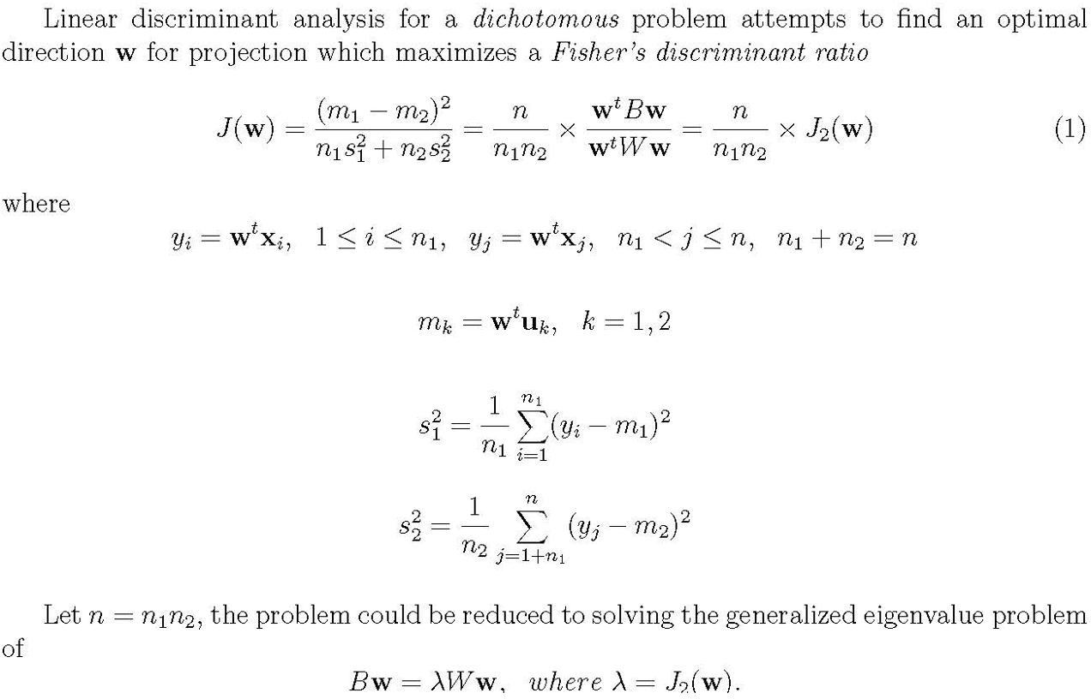
Fisher’s Discriminant Ratio

Slide 51
Fisher’s Discriminant Ratio
Similarly, for multiclass (more than 2 classes) problems, the objective is to find the first few vectors for discriminating points in different categories which is also based on optimizing J₂(w) or solving
Bw= λ Ww for the eigenvectors associated with few largest eigenvalues.

Slide 52
Linear Discriminant Analysis (LDA)
Multiple classes and PCA
Suppose there are C classes in the training data.
PCA is based on the sample covariance which characterizes the scatter of the entire data set, irrespective of class-membership.
The projection axes chosen by PCA might not provide good discrimination power.
What is the goal of LDA?
Perform dimensionality reduction while preserving as much of the class discriminatory information as possible.
Seeks to find directions along which the classes are best separated.
Takes into consideration the scatter within-classes but also the scatter between-classes.
More capable of distinguishing image variation due to identity from variation due to other sources such as illumination and expression.

Slide 53
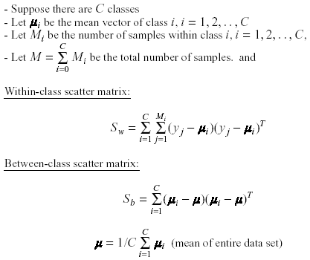
Linear Discriminant Analysis (LDA)
Methodology

Slide 54
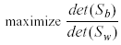
Linear Discriminant Analysis (LDA)
Methodology – cont.
LDA computes a transformation that maximizes the between-class scatter while minimizing the within-class scatter:
Such a transformation should retain class separability while reducing the variation due to sources other than identity (e.g., illumination).

Slide 55
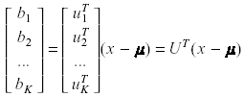
Linear Discriminant Analysis (LDA)
Linear transformation implied by LDA
The linear transformation is given by a matrix U whose columns are the eigenvectors of S_{w}⁻¹ S_{b} (called Fisherfaces).
The eigenvectors are solutions of the generalized eigenvector problem:

Slide 56

Linear Discriminant Analysis (LDA)
Does S_{w}⁻¹ always exist?
If S_{w} is non-singular, we can obtain a conventional eigenvalue problem by writing:
In practice, S_{w} is often singular since the data are image vectors with large dimensionality while the size of the data set is much smaller (M << N )

Slide 57


Linear Discriminant Analysis (LDA)
Does S_{w}⁻¹ always exist? – cont.
To alleviate this problem, we can perform two projections:
PCA is first applied to the data set to reduce its dimensionality.
LDA is then applied to further reduce the dimensionality.

Slide 58
Linear Discriminant Analysis (LDA)
Case Study: Using Discriminant Eigenfeatures for Image Retrieval
D. Swets, J. Weng, "Using Discriminant Eigenfeatures for Image Retrieval", IEEE Transactions on Pattern Analysis and Machine Intelligence, vol. 18, no. 8, pp. 831-836, 1996.
Content-based image retrieval
The application being studied here is query-by-example image retrieval.
The paper deals with the problem of selecting a good set of image features for content-based image retrieval.

Slide 59

Linear Discriminant Analysis (LDA)
Assumptions
"Well-framed" images are required as input for training and query-by-example test probes.
Only a small variation in the size, position, and orientation of the objects in the images is allowed.

Slide 60
Linear Discriminant Analysis (LDA)
Some terminology
Most Expressive Features (MEF): the features (projections) obtained using PCA.
Most Discriminating Features (MDF): the features (projections) obtained using LDA.
Computational considerations
When computing the eigenvalues/eigenvectors of S_{w}⁻¹S_{B}u_{k} = λ_{k}u_{k} numerically, the computations can be unstable since S_{w}⁻¹S_{B} is not always symmetric.
See paper for a way to find the eigenvalues/eigenvectors in a stable way.
Important: Dimensionality of LDA is bounded by C-1 --- this is the rank of S_{w}⁻¹S_{B}

Slide 61

Linear Discriminant Analysis (LDA)
Factors unrelated to classification
MEF vectors show the tendency of PCA to capture major variations in the training set such as lighting direction.
MDF vectors discount those factors unrelated to classification.

Slide 62

Linear Discriminant Analysis (LDA)
Clustering effect
Methodology
Generate the set of MEFs for each image in the training set.
Given a query image, compute its MEFs using the same procedure.
Find the k closest neighbors for retrieval (e.g., using Euclidean distance).

Slide 63

Linear Discriminant Analysis (LDA)
Experiments and results
Face images
A set of face images was used with 2 expressions, 3 lighting conditions.
Testing was performed using a disjoint set of images - one image, randomly chosen, from each individual.

Slide 64

Linear Discriminant Analysis (LDA)

Slide 65

Linear Discriminant Analysis (LDA)
correct search probes

Slide 66

Linear Discriminant Analysis (LDA)
failed search probe

Slide 67
Linear Discriminant Analysis (LDA)
Case Study: PCA versus LDA
A. Martinez, A. Kak, "PCA versus LDA", IEEE Transactions on Pattern Analysis and Machine Intelligence, vol. 23, no. 2, pp. 228-233, 2001.
Is LDA always better than PCA?
There has been a tendency in the computer vision community to prefer LDA over PCA.
This is mainly because LDA deals directly with discrimination between classes while PCA does not pay attention to the underlying class structure.
This paper shows that when the training set is small, PCA can outperform LDA.
When the number of samples is large and representative for each class, LDA outperforms PCA.

Slide 68

Linear Discriminant Analysis (LDA)
Is LDA always better than PCA? – cont.

Slide 69

Linear Discriminant Analysis (LDA)
Is LDA always better than PCA? – cont.

Slide 70

Linear Discriminant Analysis (LDA)
Is LDA always better than PCA? – cont.

Slide 71
Linear Discriminant Analysis (LDA)
Critique of LDA
Only linearly separable classes will remain separable after applying LDA.
It does not seem to be superior to PCA when the training data set is small.

Slide 72
Chapter 8.3: Nonnegative Matrix Factorization

Slide 73
Motivation
Nonnegative Matrix Factorization (NMF) is a powerful technique in linear algebra and machine learning used for dimensionality reduction, feature extraction, and data representation. It decomposes a nonnegative matrix into two lower-dimensional nonnegative matrices, which can be interpreted as parts-based representations of the original data.

Slide 74
Introduction
NMF (Nonnegative Matrix Factorization):
Theory: Perception of the whole is based on perception of its parts.
Comparison with another two matrix factorization methods:
PCA (Principal Components Analysis)
VQ (Vector Quantization )

Slide 75
Comparison:
Common features:
Represent a face as a linear combination of basis images.
Matrix factorization: V≈WH
V: (n×m) matrix. Each column of which contains n nonnegative pixel values of one of the m facial images.
W: (n×r): r columns of W are called basis images.
H: (r×m): each column of H is called encoding.
Here, r is the number of latent features or components, which is typically much smaller than n or m
The nonnegativity constraint ensures that the components in W and H are interpretable as additive parts, making NMF particularly useful in applications like image processing, text mining, and bioinformatics.

Slide 76

Cost Function
Lee, Daniel, and H. Sebastian Seung. "Algorithms for non-negative matrix factorization." Advances in neural information processing systems 13 (2000).

Slide 77

Objective
Lee, Daniel, and H. Sebastian Seung. "Algorithms for non-negative matrix factorization." Advances in neural information processing systems 13 (2000).

Slide 78

Multiplicative update rules
Lee, Daniel, and H. Sebastian Seung. "Algorithms for non-negative matrix factorization." Advances in neural information processing systems 13 (2000).

Slide 79
Implementation of NMF
Initialization
Start with a nonnegative matrix V of size m×n.
Initialize W (size m×r) and H (size r×n) with nonnegative values. Common initialization methods include random nonnegative values or using methods like Singular Value Decomposition (SVD).
Iterative Update
Repeat based on Theorem 1 & 2 steps until convergence
Stopping Criteria
Converges to a local min of the Cost function. (related to the likelihood of generating the images in V from the basis W and encoding H.
Lee, Daniel, and H. Sebastian Seung. "Algorithms for non-negative matrix factorization." Advances in neural information processing systems 13 (2000).

Slide 80

Network model of NMF

Slide 81
Semantic analysis of text doc. using NMF
A corpus of documents summarized by matrix V, where Viμ is the number of times the ith word in the vocabulary appears in the μth document.
NMF algorithm involves finding the approximate factorization of this Matrix V≈WH into a feature set W and hidden variables H, in the same way as was done for faces.

Slide 82
Semantic analysis of text doc. using NMF (cont’d)
VQ (Vector Quantization): A single hidden variable is active for each document. If the same variable is active for a group of documents, they are semantically related.
PCA: Allow activation of multiple semantic variables, but they are difficult to interpret.
NMF: It makes sense for each document to associate with some small subset of a large array of topics.
Notes:
Provides a parts-based representation, which is often more interpretable than other factorization methods like PCA (Principal Component Analysis).
Works well with sparse data, which is common in many real-world applications.

Slide 83
Limitation of NMF
Not suitable for learning parts for complex cases: require fully hierarchical models with multiple levels of hidden variables.
NMF does not learn anything about the “syntactic” relationships between parts: NMF assumes that the hidden variables are nonnegative but makes no assumption about their statistical dependency

Slide 84
Chapter 8.4: Multi-Dimensional Scaling

Slide 85

Dimensionality reduction
Objective: to find a small number of features that represent a large number of observed dimensions.
For each image: there are 64x64 = 4096 pixels (observed dimensions)

Slide 86

Dimensionality reduction
Reduced to 3-dimensional manifold: two pose variables + azimuthal lighting angle

Slide 87
Dimensionality reduction: Some Assumptions
High-dimensional data often lies on or near a much lower dimensional, curved manifold.
A good way to represent data points is by their low-dimensional coordinates.
The low-dimensional representation of the data should capture information about high-dimensional pairwise distances.

Slide 88
The basic idea of non-parametric dimensionality reduction
Represent each data point by a point in a lower dimensional space.
Choose the low-dimensional points so that they optimally represent some property of the data points (e.g. the pairwise distances).
Many different properties have been tried.
Do not insist on learning a parametric “encoding” function that maps each individual data point to its low-dimensional representative.
Do not insist on learning a parametric “decoding” function that reconstructs a data point from its low dimensional representative.

Slide 89

Multi-Dimensional Scaling (MDS)
Goal of Multidimensional scaling (MDS): Given pairwise dissimilarities, reconstruct a map that preserves distances.
From any dissimilarity (no need to be a metric)
Reconstructed map has coordinates $x_{i}=\left(x_{i1},x_{i2}\right)$ and the natural distance $||x_{i}−x_{j}||_{2}$
MDS is a family of different algorithms, each designed to arrive at optimal low-dimensional configuration (p = 2 or 3)
MDS methods include
Classical MDS
Metric MDS
Non-metric MDS

Slide 90

Distance, dissimilarity and similarity
Distance, dissimilarity and similarity (or proximity) are designed for any pair of objects in any space.
In mathematics, a distance function (that gives a distance between two objects) is also called metric, satisfying
$d\left(x,y\right)≥0$
$d(x,y)=0 if and only if x=y$
$d(x,y)=d(y,x)$
$d\left(x,z\right)≤d(x,y)+d(y,z)$
Given a set of dissimilarities, one can ask whether these values arc distances and, moreover, whether they can even be interpreted as Euclidean distances

Slide 91

Euclidean and Non-Euclidean Distance

Slide 92

Non-Euclidean Distance

Slide 93

Classical MDS Theory

Slide 94


Classical MDS Theory (Con’t)
$$b_{ij}=x_{i}^{T}x_{j}$$

Slide 95

Classical MDS Theory (Con’t)

Slide 96


Classical MDS Theory (Con’t)
Where $d_{i⋅}^{2}=\frac{1}{n}\sum_{j=1}^{n}{d_{ij}^{2}}$, $d_{⋅j}^{2}=\frac{1}{n}\sum_{i=1}^{n}{d_{ij}^{2}}$, and $d_{⋅⋅}^{2}=\frac{1}{n^{2}}\sum_{i=1}^{n}{\sum_{i=1}^{n}{d_{ij}^{2}}}$
$Λ=diag(λ_{1},λ_{2},⋯,λ_{q})$ with $λ_{1}≥λ_{2}≥⋯≥λ_{q}$

Slide 97

Classical MDS Theory (Con’t)

Slide 98

Classical MDS Algorithm
Input: $D∈ℝ^{n×n} where d_{ij}$ is the distance between $x_{i}$ and $x_{j}$; Low dimension $p$
Process:
Compute to get $d_{i⋅}^{2}$, $d_{⋅j}^{2}$, and $d_{⋅⋅}^{2}$; Finally get the matrix $B$;
Eigenvalue decomposition to $B$;
$Λ_{p}=diag(λ_{1},⋯,λ_{p})$ is the maximum $p$ eigenvalues and $V_{p}$ is the corresponding matrix of eigenvectors;
Output: $X_{p}=Λ_{p}^{1/2}V_{p}^{T}∈ℝ^{p×n}$

Slide 99

Classical MDS Theory (Con’t)

Slide 100

Distance Scaling
Classical MDS
Seeks to find an optimal configuration $x_{i}$ that gives $d_{ij}≈{\hat{d}}_{ij}=||x_{i}−x_{j}||_{2}$ as close as possible.
Distance Scaling
Relaxing $d_{ij}≈{\hat{d}}_{ij}$ from cMDS by allowing ${\hat{d}}_{ij}≈f(d_{ij})$ for some monotone function $f$.
Called metric MDS if dissimilarities $d_{ij}$ are quantitative
Called non-metric MDS if dissimilarities $d_{ij}$ are qualitative (e.g. ordinal).
Unlike cMDS, distance scaling is an optimization process minimizing stress function, and is solved by iterative algorithms.

Slide 101

Metric MDS

Slide 102

Metric MDS (Con’t)

Slide 103

cMDS vs. Sammon Mapping
Results of cMDS and Sammon mapping for p = 2: Sammon mapping better preserves inter-distances for smaller dissimilarities while proportionally squeezing the inter-distances for larger dissimilarities.

Slide 104

Non-metric MDS

Slide 105

Kruskal’s Non-metric MDS

Slide 106
Chapter 8.5: Manifold Embedding

Slide 107

Intrinsic Low Dimensional Space
Notes:
In mathematics, particularly in topology and geometry, intrinsic space can be understood as the study of spaces based on their internal structure and properties, such as distances and angles, without reference to an external coordinate system. For example, the intrinsic geometry of a surface can be studied using concepts like curvature and geodesics, which describe how the surface behaves internally.

Slide 108
Manifold Learning
Manifold learning is a kind of dimensionality reduction method that draws lessons from the concept of topological manifold. "Manifold" is a space that is homeomorphic to Euclidean space locally, in other words, it has the properties of Euclidean space locally and can be used to calculate the distance. This has brought great inspiration to dimensionality reduction methods: if a low-dimensional manifold is embedded in a high-dimensional space, the distribution of data samples in high-dimensional space is very complicated, but it still has the properties of Euclidean space locally. Therefore, it is easy to establish a reduced-dimensional mapping relationship locally, and then try to extend the local mapping relationship to the whole world.

Slide 109
Isomap: Local MDS without local optima
Instead of only modeling local distances, we can try to measure the distances along the manifold and then model these intrinsic distances (本真距离).
The main problem is to find a robust way of measuring distances along the manifold.
If we can measure manifold distances, the global optimization is easy: It’s just global MDS (i.e. PCA)
If we measure distances along the manifold, d(1,6) > d(1,4)
2-D
1
4
6
1-D

Slide 110

Isometric Mapping (Isomap)

Slide 111
Isometric Feature Mapping (Isomap)
A nonlinear method for dimensionality reduction
Finds the map that preserves the global, nonlinear geometry of the data by preserving the geodesic manifold interpoint distances
Geodesic: Shortest curve along the manifold connecting two points
First approximates the geodesic interpoint distances, then runs MDS to find the projection that preserves these distances
2 components:
- How do we measure the geodesic distances on the manifold?
- How to map points on the Euclidean space in lower dimensional space?

Slide 112
How Isomap measures intrinsic distances
Connect each datapoint to its K nearest neighbors in the high-dimensional space.
Put the true Euclidean distance on each of these links.
Then approximate the manifold distance between any pair of points as the shortest path in this “neighborhood graph”.
A
B

Slide 113
Approximating Geodesic Distances
Neighboring points: input-space distance
Faraway points: a sequence of “short hops” between neighboring points
Method: Finding shortest paths in a graph with edges connecting neighboring data points

Slide 114

Isomap Algorithm

Slide 115
Isomap Algorithm
Step | Name | Description
1 O(DN²) | Construct neighborhood graph, G | Compute matrix D_{G}={d_{X}(i,j)} d_{x}(i,j) = Euclidean distance between neighbors
2 O(DN²) | Compute shortest paths between all pairs | Compute matrix D_{G}={d_{G}(i,j)} d_{G}(i,j) = sequence of hops = approx geodesic dist.
3 O(dN²) | Construct k-dimensional coordinate vectors | Apply MDS to D_{G} instead of D_{X}

Slide 116

Isomap Output
The 2-D embedding recovered by Isomap

Slide 117
Summary on Isomap Algorithm
Advantages:
Nonlinear
Non-iterative
Globally optimal
Parameters: k or ε (chosen fixed radius)
Disadvantages:
Graph discreteness overestimates the geodesic distance
If the nearest neighbor range is large, the distant point may be mistaken for the nearest neighbor, thus the problem of "short circuit" appears. (短路)
If the nearest neighbor range is small, some areas in the diagram may not be connected with other areas, and thus the problem of “open circuit” appears. (断路)

Slide 118

Using Isomap to discover the intrinsic manifold in a set of face images

Slide 119

Linear methods cannot interpolate properly between the leftmost and rightmost images in each row.
This is because the interpolated images are NOT averages of the images at the two ends.
Isomap does not interpolate properly either because it can only use examples from the training set. It cannot create new images.
But it is better than linear methods.

Slide 120
Chapter 8.6: Locally Linear Embedding

Slide 121

Maps that preserve local geometry
The idea is to make the local configurations of points in the low-dimensional space resemble (类似于) the local configurations in the high-dimensional space.
We need a coordinate-free way of representing a local configuration.
If we represent a point as a weighted average of nearby points, the weights describe the local configuration.
$$x_{i}=\sum_{j∈N\left(i\right)}{w_{ij}x_{j}}$$

Slide 122

Finding the optimal weights
Minimize the squared “construction” errors subject to the sum of the weights being 1.
$$cost=\sum_{i=1}^{n}{||x_{i}−\sum_{j∈N\left(i\right)}{w_{ij}x_{i}}||_{2}^{2}} s.t. \sum_{j∈N\left(i\right)}{w_{ij}}=1$$
If the construction is done using less neighbors than the dimensionality of $x$, there will generally be some construction error
The error will be small if there are as many neighbors as the dimensionality of the underlying noisy manifold.

Slide 123

A sensible but inefficient way to use the local weights
Assume a low-dimensional latent space.
Each datapoint $x_{i}$ has latent coordinates $z_{i}$.
Find a set of latent points that minimize the construction errors produced by a two-stage process:
1. First use the latent points to compute the local weights that construct $z_{i}$ from its neighbors.
2. Use those weights to construct the high-dimensional coordinates of a datapoint $x_{i}$ from the high-dimensional coordinates of its neighbors.
Unfortunately, this is a hard optimization problem.
Iterative solutions are expensive because they must repeatedly measure the construction error in the high-dimensional space.

Slide 124
Locally Linear Embedding (LLM)
Instead of using the the latent points plus the other datapoints to construct each held-out datapoint, do it the other way around.
Use the datapoints to determine the local weights, then try to construct each latent (low-D) point from its neighbors.
Now the construction error is in the low-dimensional latent space.
We only use the high-dimensional space once to get the local weights.
The local weights stay fixed during the optimization of the latent coordinates.
This is a much easier search.

Slide 125

Locally Linear Embedding (LLM)

Slide 126


The convex optimization
Find the z’s that minimize the cost subject to the constraint that the z’s have unit variance on each dimension.
Why do we need to impose a constraint on the variance?
$$cost=\sum_{i=1}^{n}{||z_{i}−\sum_{j∈N\left(i\right)}{w_{ij}z_{i}}||_{2}^{2}}$$
$$ZZ^{T}=I$$
Where $Z=(z_{1},⋯,z_{n})$
fixed weights
Notes:
Normalization: By enforcing unit variance, we ensure that the scale of the data does not disproportionately affect the distance calculations. This normalization helps in maintaining the relative distances between points, which is crucial for preserving local structures.
Stability: Unit variance can lead to more stable numerical computations. When data is not normalized, certain dimensions may dominate the distance calculations, leading to skewed results.
Interpretability: Having unit variance allows for easier interpretation of the results. It ensures that the embedded dimensions are comparable and that the variance in each dimension reflects the same scale.

Slide 127
The collapse problem
If all of the latent points are identical, we can construct each of them perfectly as a weighted average of its neighbors.
The root cause of this problem is that we are optimizing the wrong thing.
But maybe we can fix things up by adding a constraint that prevents collapse.
Insist that the latent points have unit variance on each latent dimension.
This helps a lot, but sometimes LLE can satisfy this constraint without doing what we really intend.

Slide 128
Failure modes of LLE
If the neighborhood graph has several disconnected pieces, we can satisfy the unit variance constraint and still have collapses.
Even if the graph is fully connected, it may be possible to collapse all the densely connected regions and satisfy the variance constraint by paying a high cost for a few outliers.

Slide 129
A typical embedding found by LLE
LLE embeddings often look like this.
Most of the data is close to the center of the space.
A few points are far from the center to satisfy the unit variance constraint.

Slide 130
A comment on LLE
It has two very attractive features
1. The only free parameters are the dimensionality of the latent space and the number of neighbors that are used to determine the local weights.
2. The optimization is convex so we don’t need multiple tries and we don’t need to fiddle with optimization parameters.
It has one bad feature:
It is not optimizing the right thing!
One consequence is that it does not have any incentive to keep widely separated datapoints far apart in the low-dimensional map.

Slide 131
A probabilistic version of local MDS
It is more important to get local distances right than non-local ones, but getting infinitesimal distances right is not infinitely important.
All the small distances are about equally important to model correctly.
Stochastic neighbor embedding (SNE) has a probabilistic way of deciding if a pairwise distance is “local”.
SNE 的主要目标是将高维数据嵌入到低维空间中，同时尽可能保留数据点之间的相似性。

Slide 132
Stochastic Neighbor Embedding (SNE)
First convert each high-dimensional similarity into the probability that one data point will pick the other data point as its neighbor.
To evaluate a map:
Use the pairwise distances in the low-dimensional map to define the probability that a map point will pick another map point as its neighbor.
Compute the Kullback-Leibler (KL) divergence between the probabilities in the high-dimensional and low-dimensional spaces.

Slide 133
A probabilistic local method
Each point in high-D has a conditional probability of picking each other point as its neighbor.
The distribution over neighbors is based on the high-D pairwise distances.
If we do not have coordinates for the datapoints we can use a matrix of dissimilarities instead of pairwise distances.
High-D Space
k
j
i
probability of picking j given that you start at i
Notes:
\sigma_i​是与点xi相关的高斯宽度，控制了点xi的邻域大小。

Slide 134

Throwing away the raw data
The probabilities that each points picks other points as its neighbor contains all of the information we are going to use for finding the manifold.
Once we have the probabilities $p_{j|i}$ we do not need to do any more computations in the high-dimensional space.
The input could be “dissimilarities” between pairs of datapoints instead of the locations of individual datapoints in a high-dimensional space.

Slide 135
Evaluating an arrangement of the data in a low-D space
Give each datapoint a location in the low-dimensional space.
Evaluate this representation by seeing how well the low-D probabilities model the high-D ones.
Low-D Space
j
k
i
probability of picking j given that you start at i

Slide 136

The cost function for a low-dimensional representation
For points where $p_{j|i}$ is large and $q_{j|i}$ is small we lose a lot.
Nearby points in high-D really want to be nearby in low-D
For points where $q_{j|i}$ is large and $p_{j|i}$ is small we lose a little because we waste some of the probability mass in the $Q_{i}$ distribution.
Widely separated points in high-D have a mild preference for being widely separated in low-D.

Slide 137

The forces acting on the low-dimensional points
$$\frac{∂Cost}{∂z_{i}}=2\sum_{j}{\left(z_{j}−z_{i}\right)}\left(p_{j|i}−q_{j|i}+p_{i|j}−q_{i|j}\right)$$
Points are pulled towards each other if the p’s are bigger than the q’s and repelled if the q’s are bigger than the p’s
j
i

Slide 138

Unsupervised SNE embedding of the digits 0-4. Not all the data is displayed

Slide 139
Picking the radius of the Gaussian that is used to compute the p’s
We need to use different radius in different parts of the space so that we keep the effective number of neighbours about constant.
A big radius leads to a high entropy for the distribution over neighbours of i.
A small radius leads to a low entropy.
So decide what entropy you want and then find the radius that produces that entropy.
Its easier to specify 2^entropy
This is called the perplexity
It is the effective number of neighbours.

Slide 140
Symmetric SNE
There is a simpler version of SNE which seems to work about equally well.
Symmetric SNE works best if we use different procedures for computing the p’s and the q’s
This destroys the nice property that if we embed in a space of the same dimension as the data, the data itself is the optimal solution.

Slide 141
Computing the p’s for symmetric SNE
Each high dimensional point, i, has a conditional probability of picking each other point, j, as its neighbor.
The conditional distribution over neighbors is based on the high-dimensional pairwise distances.
High-D Space
k
j
i
probability of picking j given that you start at i

Slide 142
Turning conditional probabilities into pairwise probabilities
To get a symmetric probability between i and j we sum the two conditional probabilities and divide by the number of points (points are not allowed to choose themselves).
This ensures that all the pairwise probabilities sum to 1 so they can be treated as probabilities.
joint probability of picking the pair i,j

Slide 143
Evaluating an arrangement of the points in the low-D space
Give each data-point a location in the low-dimensional space.
Define low-dimensional probabilities symmetrically.
Evaluate the representation by seeing how well the low-D probabilities model the high-D affinities.
Low-D Space
j
k
i

Slide 144
The cost function for a low-dimensional representation
It’s a single KL instead of the sum of one KL for each datapoint.

Slide 145

The forces acting on the low-dimensional points
extension stiffness
$$\frac{∂KL(P||Q)}{∂z_{i}}=2\sum_{j}{\left(z_{j}−z_{i}\right)}\left(p_{ij}−q_{ij}\right)$$
Points are pulled towards each other if the p’s are bigger than the q’s and repelled if the q’s are bigger than the p’s
Its equivalent to having springs whose stiffnesses are set dynamically.
j
i

Slide 146


Slide 147
Optimization methods for SNE
We get much better global organization if we use annealing.
Add Gaussian noise to the z locations after each update.
Reduce the amount of noise on each iteration.
Spend a long time at the noise level at which the global structure starts to form from the hot plasma of map points.
It also helps to use momentum (especially at the end).
It helps to use an adaptive global step-size.

Slide 148
Optimization hacks
Reputable hack: Introduce a penalty term that keeps all the map-points close together.
Then gradually relax the penalty to break symmetry slowly.
Disreputable hack: Allow the probabilities to add up to 4.
This causes the map-points to curdle into small clusters leaving lots of space for clusters to move past each other.
Then make the probabilities add up to 1.

Slide 149



t-SNE
Manifold Learning Suitable for clustering or following supervised learning
Notes:
SNE的一个重要改进是t-分布随机邻居嵌入 (t-SNE)，它使用 t-分布代替高斯分布来计算低维空间中的相似性。这种方法在处理高维数据时能够更好地保持局部结构，并且在可视化时效果更佳。

Slide 150







Locally Linear Embedding (LLE)
$w_{ij}$ represents the relation between $x^{i}$ and $x^{j}$
$$x^{j}$$
$$w_{ij}$$
Find a set of $w_{ij}$ minimizing
$$x^{i}$$
$$\sum_{i}{{\left\|x^{i}−\sum_{j}{w_{ij}x^{j}}\right\|}_{2}}$$
Then find the dimension reduction results $z^{i}$ and $z^{j}$ based on $w_{ij}$

Slide 151









Locally Linear Embedding (LLE)
Find a set of $z^{i}$ minimizing
$$\sum_{i}{{\left\|z^{i}−\sum_{j}{w_{ij}z^{j}}\right\|}_{2}}$$
Keep $w_{ij}$ unchanged
$$x^{j}$$
$$z^{j}$$
$$w_{ij}$$
$$z^{i}$$
$$x^{i}$$
$$w_{ij}$$
Original Space
New (Low-dim) Space

Slide 152

Locally Linear Embedding (LLE)
Lawrence K. Saul, Sam T. Roweis, “Think Globally, Fit Locally: Unsupervised Learning of Low Dimensional Manifolds”, JMLR, 2013

Slide 153

Laplacian Eigenmaps
Graph-based approach
Distance defined by graph approximate the distance on manifold
Construct the data points as a graph

Slide 154








Laplacian Eigenmaps
Review in semi-supervised learning: If $x^{1}$ and $x^{2}$ are close in a high density region, ${\hat{y}}^{1}$ and ${\hat{y}}^{2}$ are probably the same.
similarity
$$w_{i,j}=$$
If connected
0
otherwise
$$L=\sum_{x^{r}}{C\left(y^{r},{\hat{y}}^{r}\right)}$$
$$+λS$$
As a regularization term
$$S=\frac{1}{2}\sum_{i,j}{w_{i,j}{\left(y^{i}−y^{j}\right)}^{2}}$$
$$=y^{T}Ly$$
L: (R+U) x (R+U) matrix
S evaluates how smooth your label is
Graph Laplacian
$$L=D−W$$

Slide 155


Laplacian Eigenmaps
Dimension Reduction: If $x^{1}$ and $x^{2}$ are close in a high density region, $z^{1}$ and $z^{2}$ are close to each other.
$$S=\frac{1}{2}\sum_{i,j}{w_{i,j}{\left(z^{i}−z^{j}\right)}^{2}}$$
Any problem?
How about $z^{i}=z^{j}=0$?
Giving some constraints to z:
If the dim of z is M,
Span{z¹, z², … z^{N}} = R^{M}
Spectral clustering: clustering on z
Belkin, M., Niyogi, P. Laplacian eigenmaps and spectral techniques for embedding and clustering. Advances in neural information processing systems . 2002

Slide 156


T-distributed Stochastic Neighbor Embedding (t-SNE)
Problem of the previous approaches
Similar data are close, but different data may collapse
LLE on MNIST
LLE on COIL-20
Notes:
http://www1.cs.columbia.edu/CAVE/software/softlib/coil-20.php

Slide 157






t-SNE
x
z
Compute similarity between all pairs of x: $S\left(x^{i},x^{j}\right)$
Compute similarity between all pairs of z: $S′\left(z^{i},z^{j}\right)$
$$P\left(x^{j}|x^{i}\right)=\frac{S\left(x^{i},x^{j}\right)}{\sum_{k≠i}{S\left(x^{i},x^{k}\right)}}$$
$$Q\left(z^{j}|z^{i}\right)=\frac{S′\left(z^{i},z^{j}\right)}{\sum_{k≠i}{S′\left(z^{i},z^{k}\right)}}$$
Find a set of z making the two distributions as close as possible
$$L=\sum_{i}{KL\left(P\left(∗|x^{i}\right)||Q\left(∗|z^{i}\right)\right)}$$
$$=\sum_{i}{\sum_{j}{P\left(x^{j}|x^{i}\right)log\frac{P\left(x^{j}|x^{i}\right)}{Q\left(z^{j}|z^{i}\right)}}}$$
Notes:
Why KL>

Slide 158









t-SNE –Similarity Measure
Ignore $σ$ for simplicity
SNE:
$$S\left(x^{i},x^{j}\right)$$
$$S′\left(z^{i},z^{j}\right)=exp\left(−{\left\|z^{i}−z^{j}\right\|}_{2}\right)$$
$$=exp\left(−{\left\|x^{i}−x^{j}\right\|}_{2}\right)$$
t-SNE:
$$S′\left(z^{i},z^{j}\right)=1/{1+{\left\|z^{i}−z^{j}\right\|}_{2}}$$
$$1/{1+{\left\|z^{i}−z^{j}\right\|}_{2}}$$
$$exp\left(−{\left\|x^{i}−x^{j}\right\|}_{2}\right)$$
${\left\|x^{i}−x^{j}\right\|}_{2}$ , ${\left\|z^{i}−z^{j}\right\|}_{2}$

Slide 159


t-SNE
Good at visualization
t-SNE on MNIST
t-SNE on COIL-20
Notes:
http://www1.cs.columbia.edu/CAVE/software/softlib/coil-20.php

Slide 160
Two other state-of-the-art dimensionality reduction methods on the 6000 MNIST digits
Isomap
Locally Linear Embedding

Slide 161
t-SNE on the 6000 MNIST digits

Slide 162

The COIL20 dataset
Each object is rotated about a vertical axis to produce a closed one-dimensional manifold of images.

Slide 163
Isomap & LLE for COIL20 dataset
Isomap
Locally Linear Embedding

Slide 164

t-SNE for COIL20 dataset

Slide 165

Using t-SNE to see what you are thinking

Slide 166


